Slide 1
Retail-Giant Sales Forecasting Case Study SUBMISSION
Sujay DSa (DDA1610008)

Slide 2
Abstract
Global Mart is an online store having worldwide operations. It takes orders and delivers across the globe and deals with all the major product categories - consumer, corporate & home office.
The presentation walk us through the most frequently purchased items bought together.

Slide 3
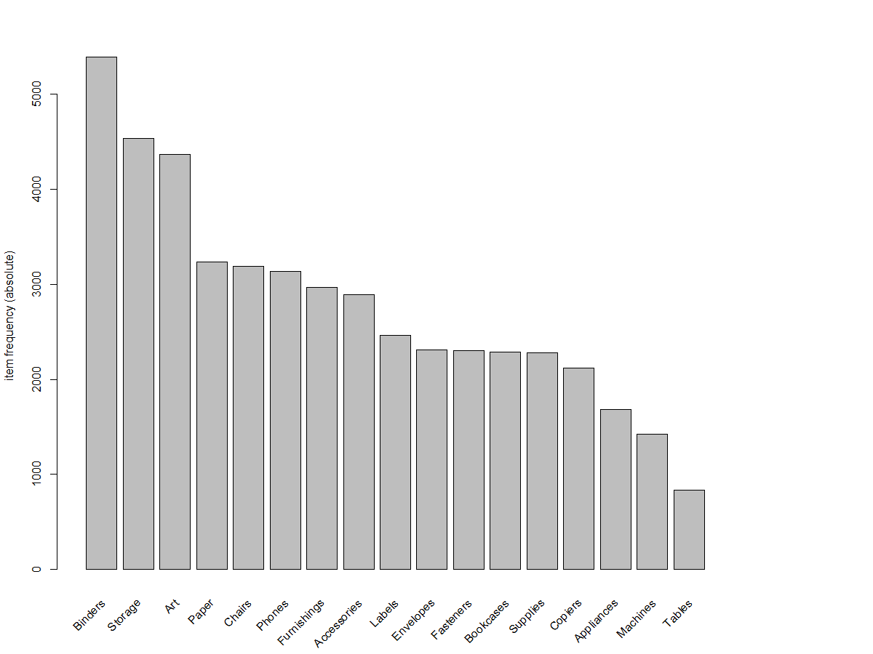
Most popular items
Binders, Storage, Art, Paper and Chairs are the most popular items purchased from the store. We will analyze how many of these are purchased together and come up with a strategy based on our analysis.

Slide 4
Top Frequent Itemsets Based on confidence
[1] {Appliances,Art,Furnishings,Storage} => {Binders}
[2] {Accessories,Labels,Phones,Storage} => {Binders}
[3] {Appliances,Machines,Storage} => {Art}
[4] {Appliances,Art,Binders,Furnishings} => {Storage}
[5] {Appliances,Paper,Storage} => {Binders}
[6] {Appliances,Furnishings,Storage} => {Binders}
[7] {Fasteners,Labels,Machines} => {Art}
[8] {Appliances,Fasteners,Paper} => {Binders}
[9] {Art,Chairs,Paper,Storage} => {Binders}
[10] {Appliances,Fasteners,Phones} => {Binders}
From the above list, we can observe that Binders, Storage, Art are not only popular items but also most likely to be purchased along with certain other items.

Slide 5
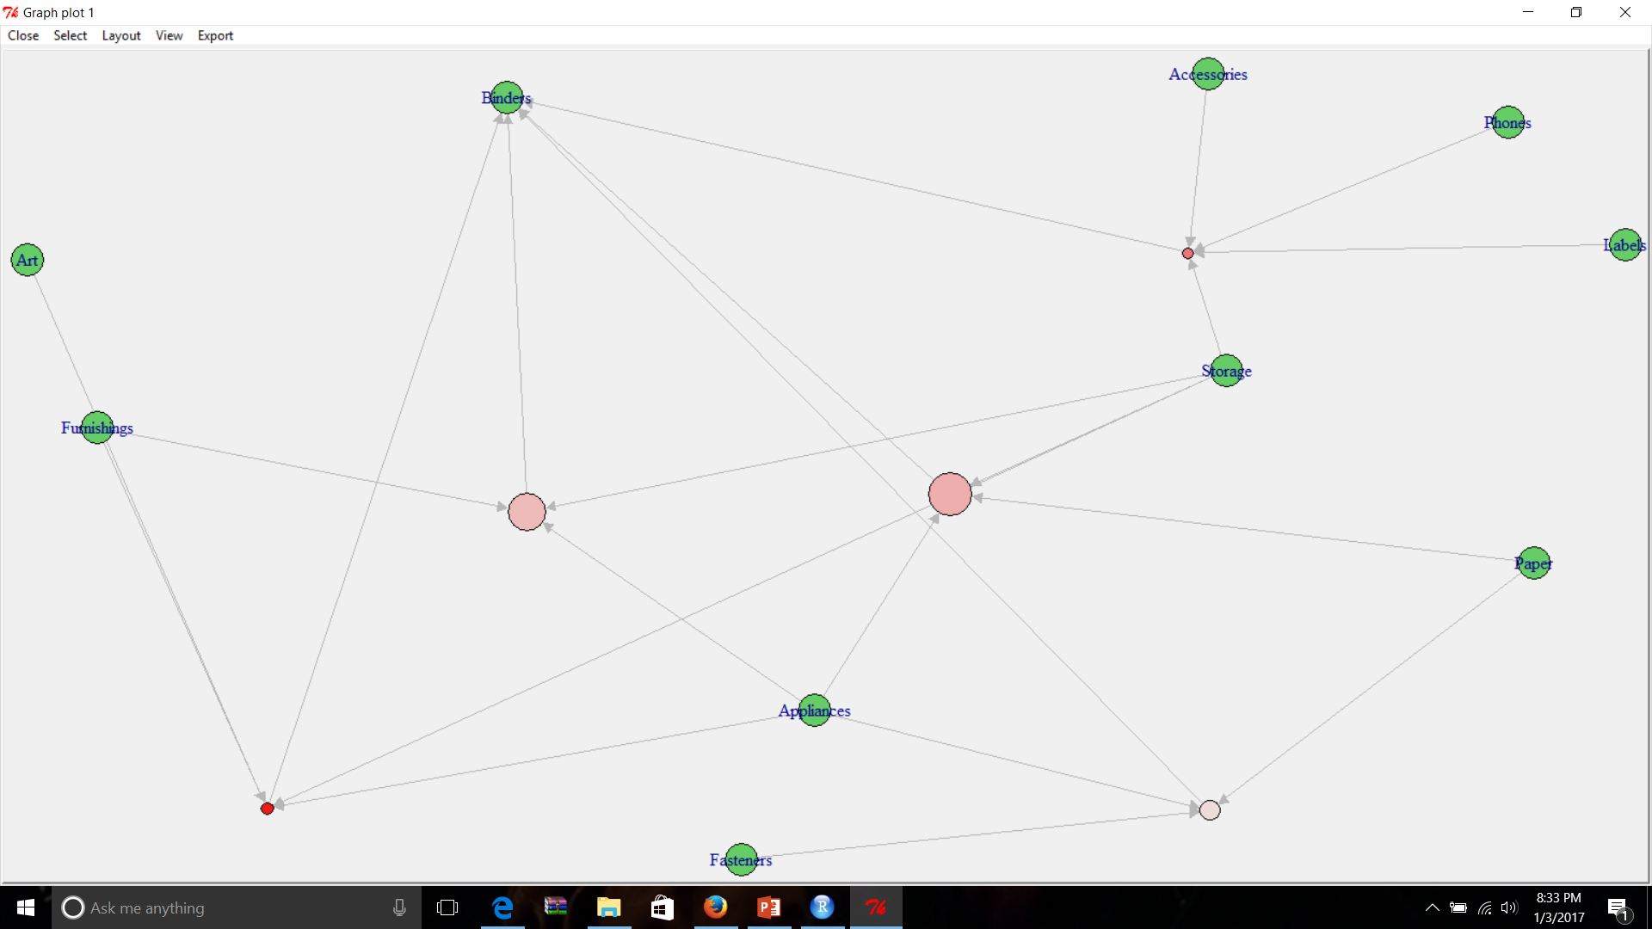
Frequent Items Resulting in the purchase of Binders

Slide 6
Analysis of Binder Plot
From the plot it is evident that binders are most likely to be purchased along with
the following
Paper, Storage, Appliances
Furnishing, storage and appliances
This is interesting because apart from Furnishings and Appliances the other items are actually among the top 5 most popular items purchased. Which would mean that, it is very likely that if these items are placed together, people who come to purchase any one of these items might just make up their mind to purchase Binders as well.

Slide 7
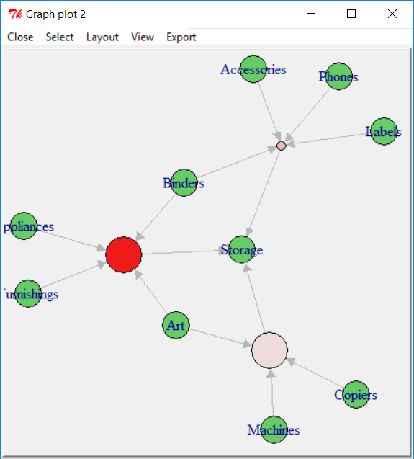
Frequent Items Resulting in the purchase of Storage

Slide 8
Analysis of Storage Plot
From the plot it is evident that Storage is most likely to be purchased along with
the following
Furnishings, Binders, Art, Appliances
This is interesting because apart from Furnishings and Appliances the other items are actually among the top 5 most popular items purchased. Which would mean that, it is very likely that if these items are placed together, people who come to purchase any one of these items might just make up their mind to purchase Binders as well.

Slide 9
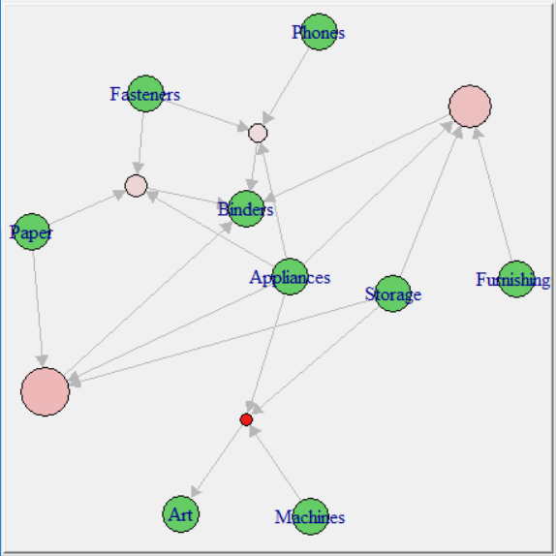
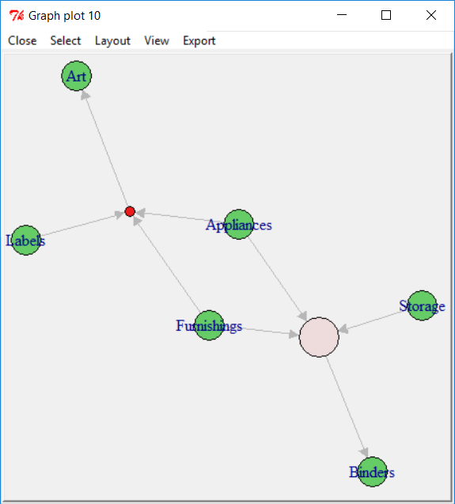
Analysis of Itemsets Containing Less Popular items

Slide 10
Analysis And Conclusion
From both the plots above it does infact appear that furnishings and appliances usually go together.
along with binders or storage resulting in the purchase of a popular item
Binders are likely to be picked up 60% of the time if placed along with Storage, Appliances and furnishings.
These are all items related to office supplies and are very good choices to be placed close to each other for customer convenience.
Storage is also likely to be picked up 60% of the time given it is placed close to
Furnishings, Binders, Art, Appliances.
Effectively, it would be wise to place Furnishings, Binders, Art, Appliances, storage together as these are most likely the items which customers usually buy together. It saves effort and time for the customer to allow them to shop for other products.

